Slide 1

CUSTOMER RETENSTION
CASE STUDY PROJECT
Submitted by :-
K.Vineeth Nair

Slide 2
Problem statement:
Customer satisfaction has emerged as one of the most important factors that guarantee the success of online store; it has been posited as a key stimulant of purchase, repurchase intentions and customer loyalty. A comprehensive review of the literature, theories and models have been carried out to propose the models for customer activation and customer retention. Five major factors that contributed to the success of an e-commerce store have been identified as: service quality, system quality, information quality, trust and net benefit. The research furthermore investigated the factors that influence the online customers repeat purchase intention. The combination of both utilitarian value and hedonistic values are needed to affect the repeat purchase intention (loyalty) positively. The data is collected from the Indian online shoppers. Results indicate the e-retail success factors, which are very much critical for customer satisfaction.
In this project, a dataset was provided containing the details of the participants of a survey, along with their online shopping experiences, preferences, and opinions regarding various ecommerce websites.
The Dataset was first checked for null values, and then the various feature columns were analyzed. Exploratory Data analysis was conducted to investigate the relationships that existed between the columns, using various visualization techniques.
The dataset was worked with to study and understand with several perceived risks helped to understand Customer retention and loyalty to various ecommerce websites.

Slide 3
Data preparation cleaning:
Reading the CSV file and doing initial statistical analysis (shape, values etc)
Data Pre-processing: Reading the unique values for each column and removing those which won’t be significant in the analysis further.
Create a new data frame to proceed with the analysis further.
EDA Concluding Remarks:
Find patterns of data through visualization and reveal the hidden trends from data.
Using both matplotlib and seaborn library to visualize the data.
Finding relationships between features.
Analyzing both the numerical and the categorical columns separately.
HARDWARE: ACER ASPIRE E15
SOFTWARE:
Jupyter Notebook (Anaconda 3) – Python 3
Microsoft Office 365 Package

Slide 4
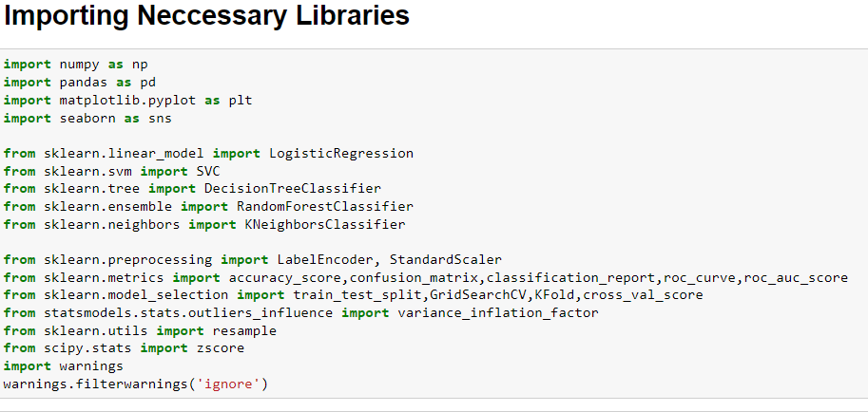
Libraries used:

Slide 5
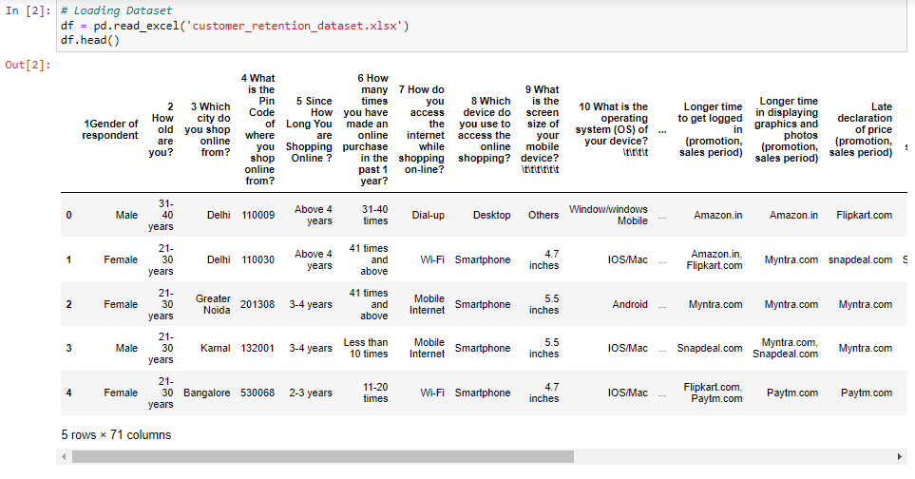
About the Dataset:

Slide 6
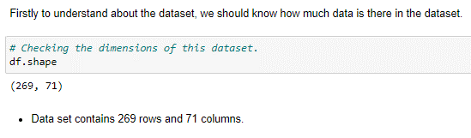
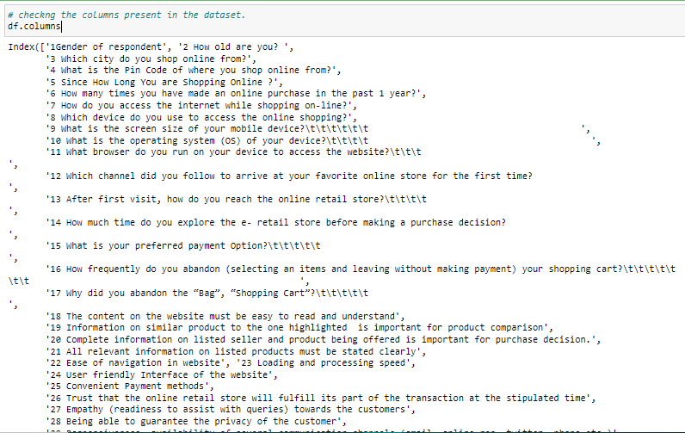
Exploratory Data Analysis (EDA)
There is space and characters present in the dataset.

Slide 7
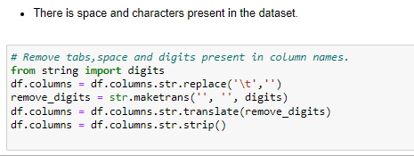
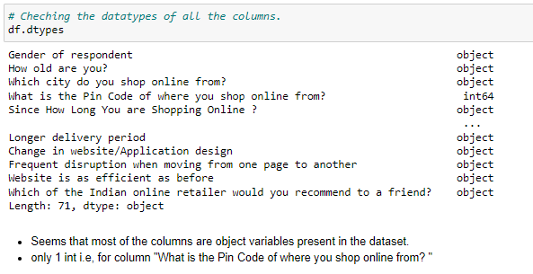
Tabs and Spaces between the column headings are successfully removed.

Slide 8
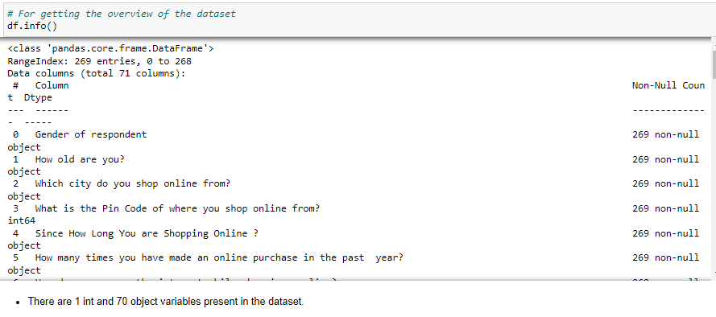
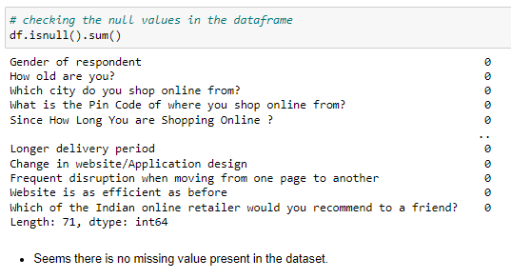

Slide 9
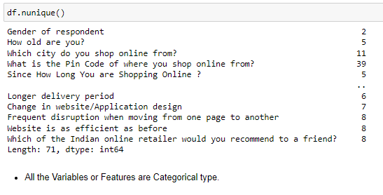
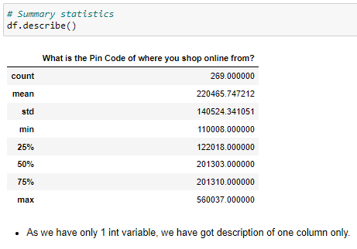

Slide 10
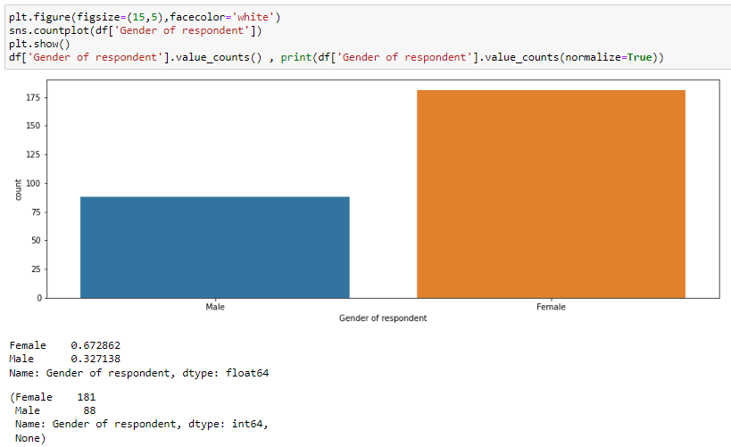
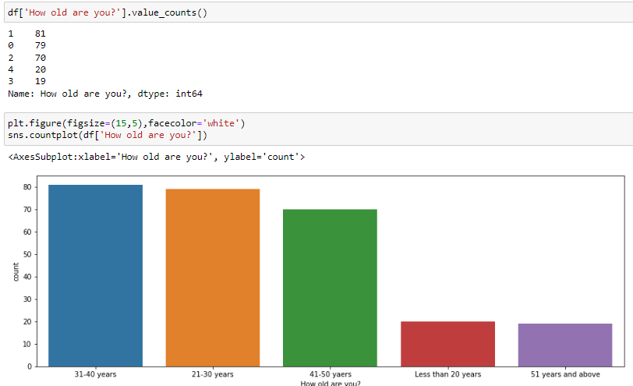
Data Visualization
Maximum count is 81 between the age group of 31-40 years and Minimum count is 19 of the age group of 51 years and above.
As we can See Majority (181 count/ 67.3%) are Female compare to Male (88 count/ 32.7%)..

Slide 11
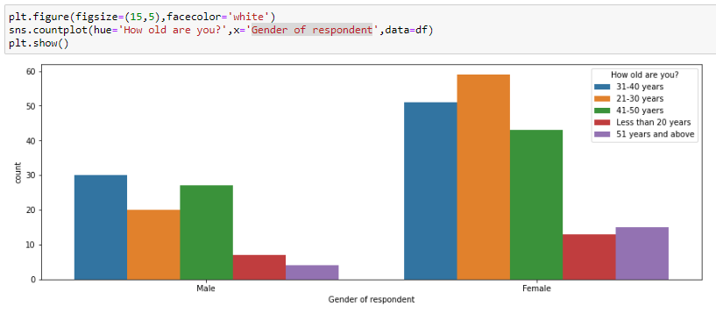
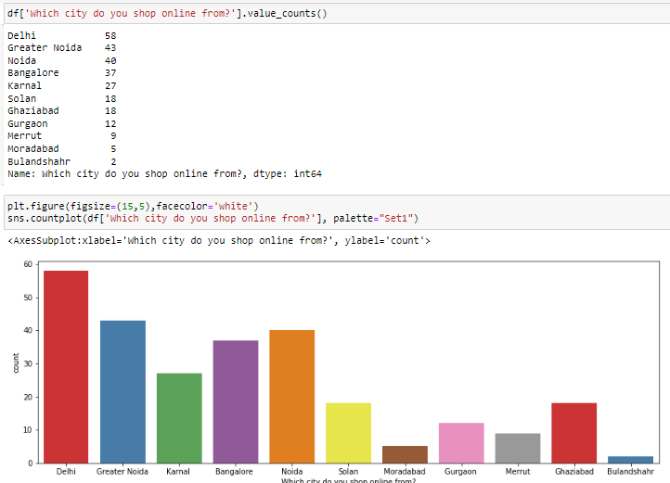
Maximum count in male group is between the age group of 31-40 years and Minimum count is of 51 years and above.
Maximum count in female group is between the age group of 21-30 years and Minimum count is less than 20 years.
Maximum count is 58 from Delhi and Minimum count is 2 from Bulandshahr

Slide 12
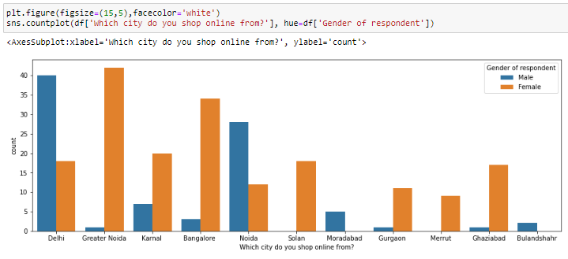
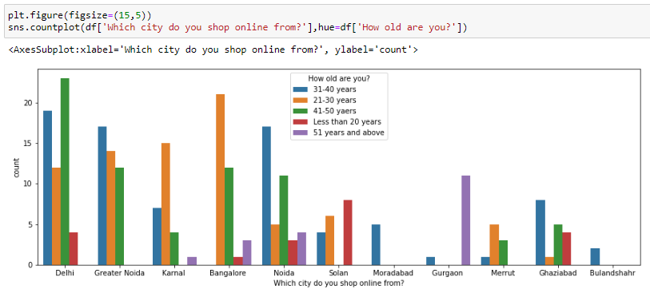
Customers between 31-40 and 41-50 years of age prefer to shop online compare to other age group in Delhi.
Customers between 21-30 years of age prefer to shop online compare to other age group in Bangalore.
In Delhi mostly Male prefer to shop online whereas females from Greater Noida prefer to shop online.

Slide 13
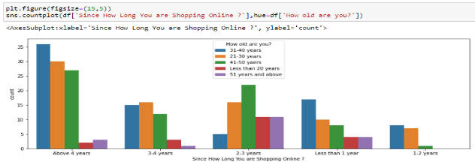
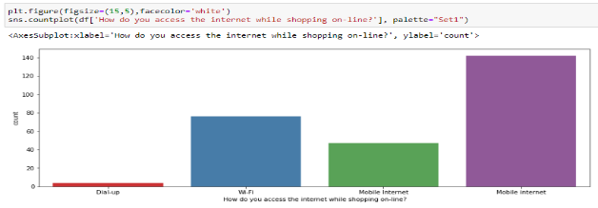
Customers between 21-30, 31-40 and 41-50 years of age are shopping online for more than 4 Years.
Customers mostly use Mobile internet and Wi-Fi than Dial up for online shopping.

Slide 14
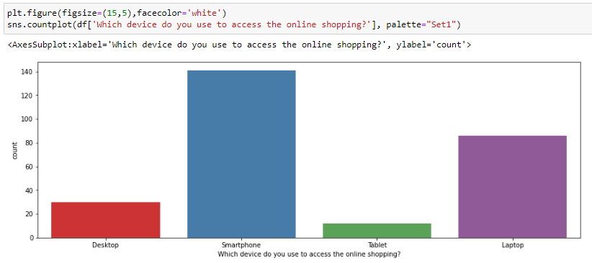
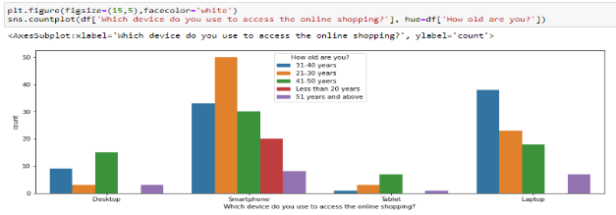
Customers use Smartphone and laptop for online shopping than Desktop and Tablet.
Majority Customers using Smartphone for online shopping are between 21-30 years of age group.
Whereas using Laptop for online shopping are between 31-40 years of age group.

Slide 15
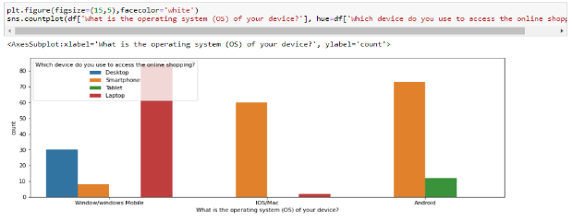
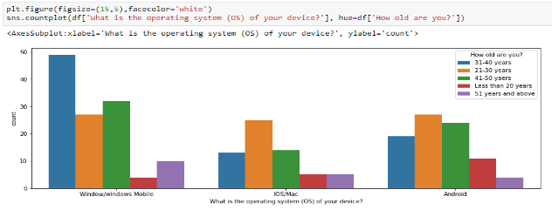
Majority Customers using Smartphone for online shopping are Andriod or IOS/Mac operating System users.
Whereas using Laptop users are using Windows operating System.
Majority Customers using Windows operating System for online shopping are of 31-40 years of age group.

Slide 16
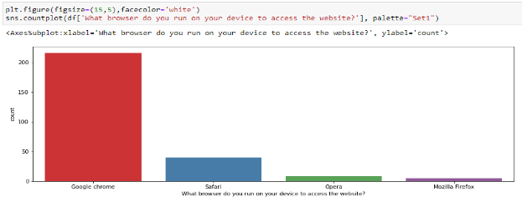
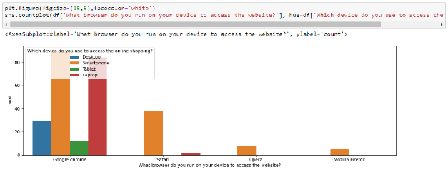
Majority Customers using Google Chrome as web browser use Smartphone and Laptop for online shopping.
Majority Customers using Google Chrome as web browser for online shopping.

Slide 17
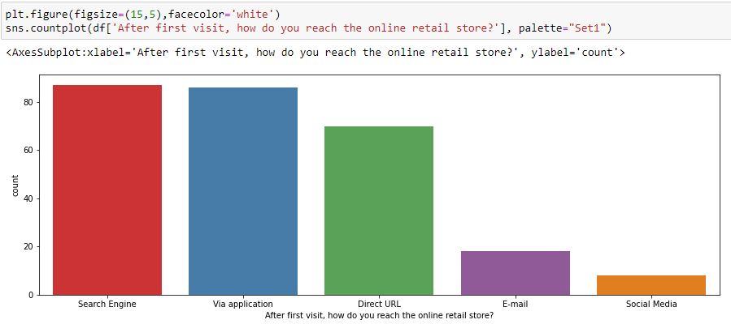
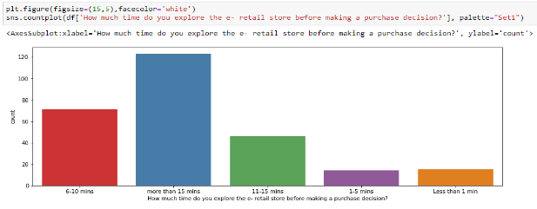
Majority Customers reach the online retail store through Search Engine or Via application or Direct URL.
Majority Customers explore for more than 15- mins before making a purchase decision.

Slide 18
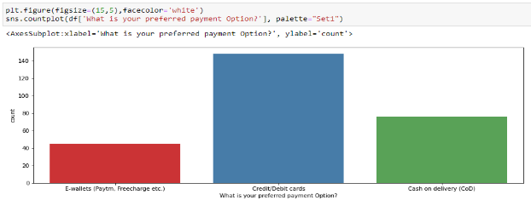
Majority Customers prefer for Card/Debit cards as payment option for online shopping.

Slide 19
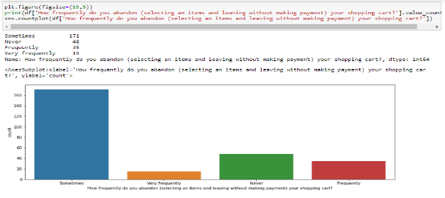
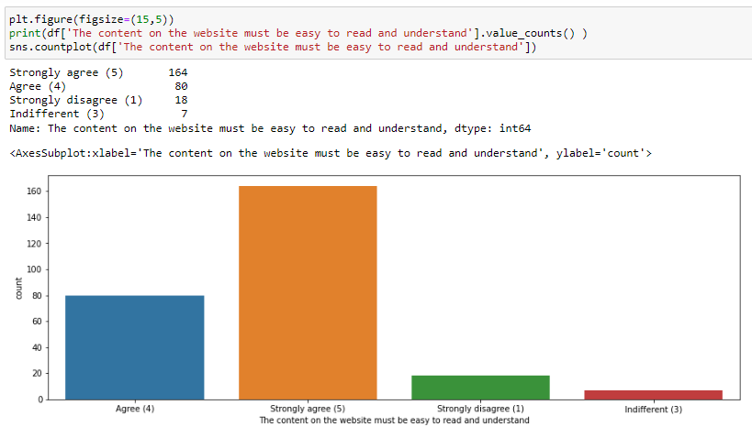
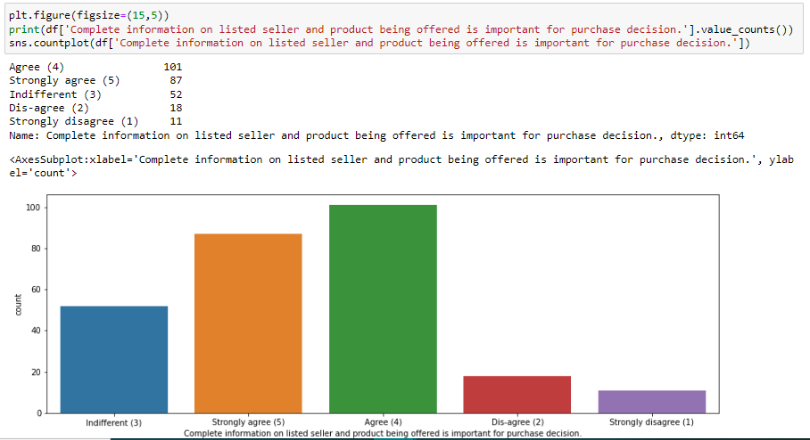
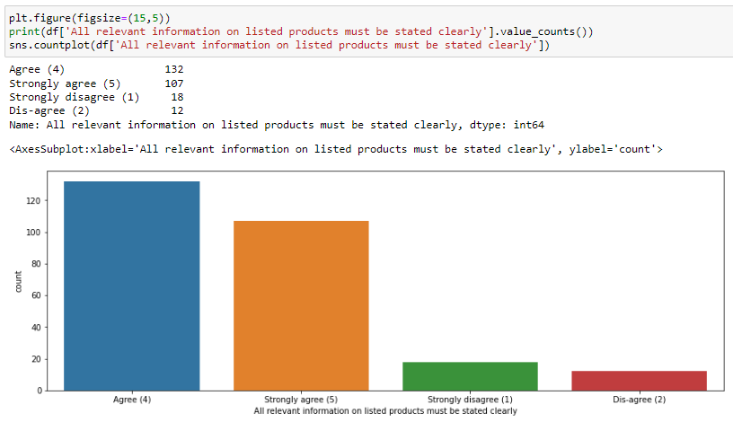

Slide 20
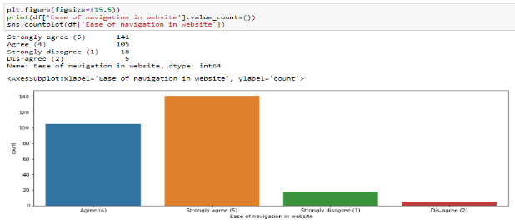
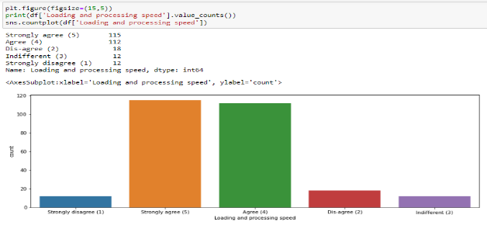
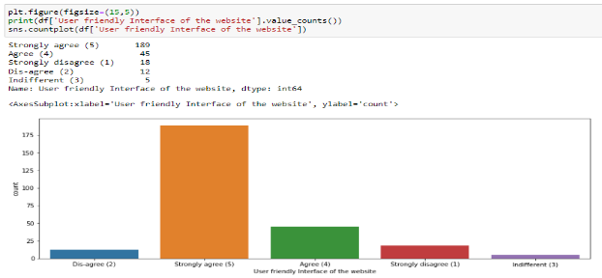
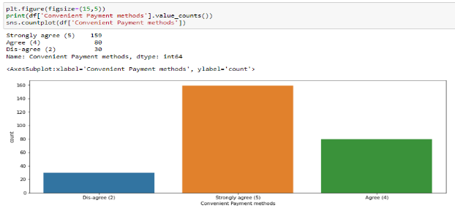

Slide 21
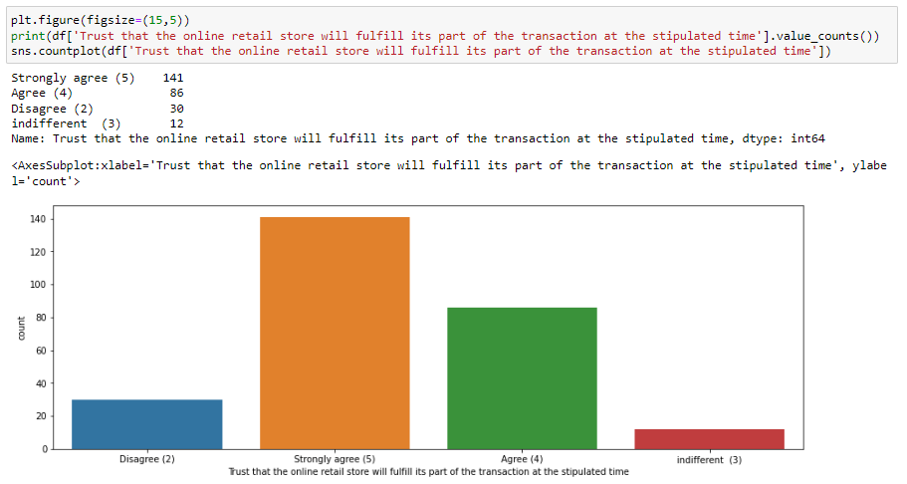
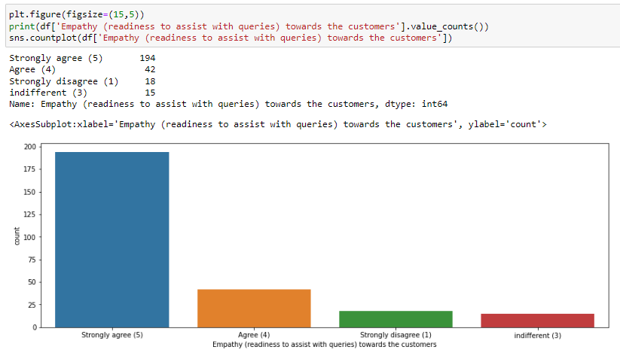
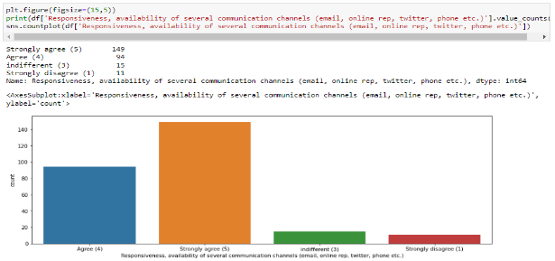
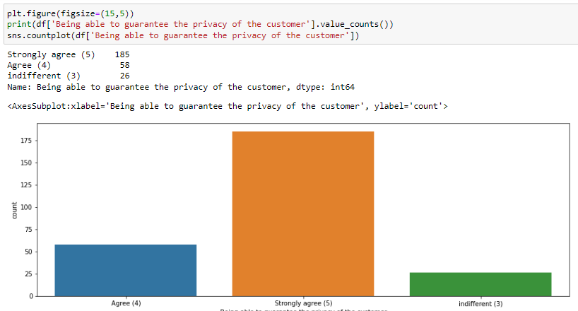

Slide 22
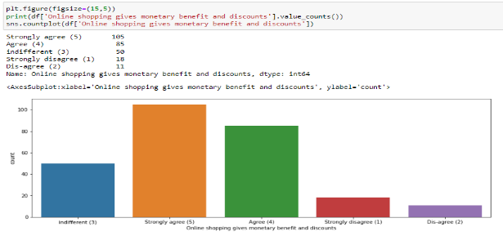
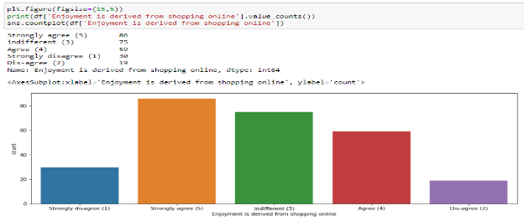
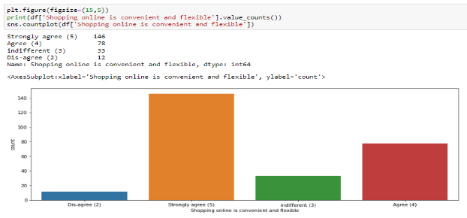
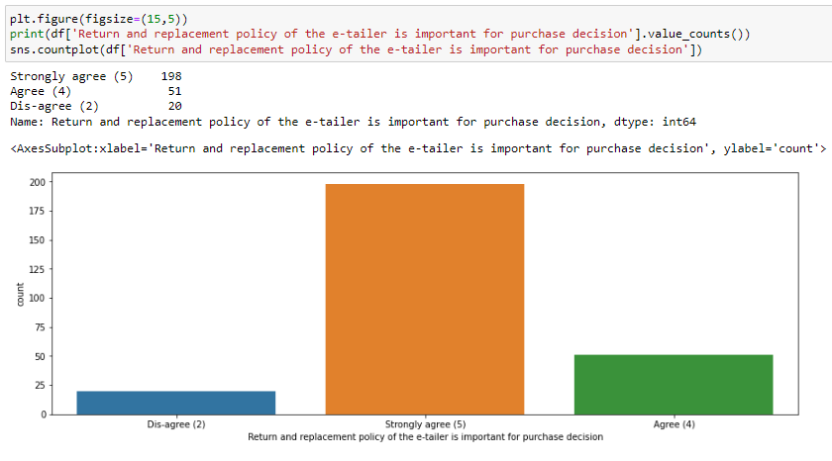

Slide 23
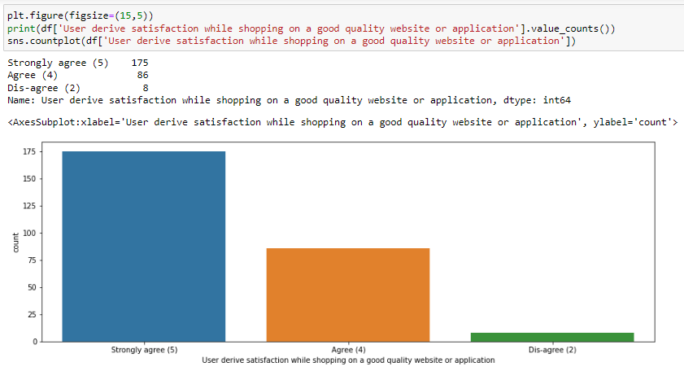
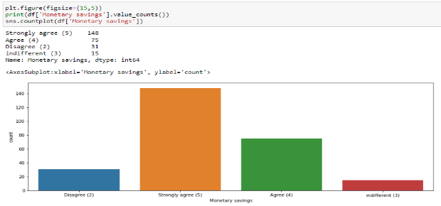

Slide 24
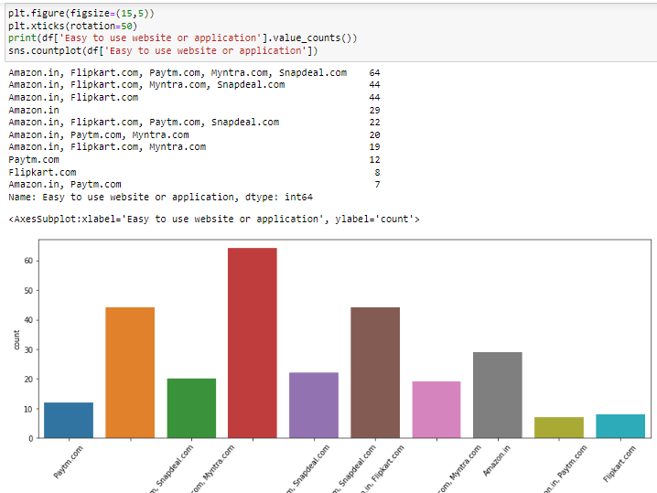
Majority Customers have strongly agreed that Amazon.in is the easy to use website or application with second place for Flipkart.com and rest following.

Slide 25
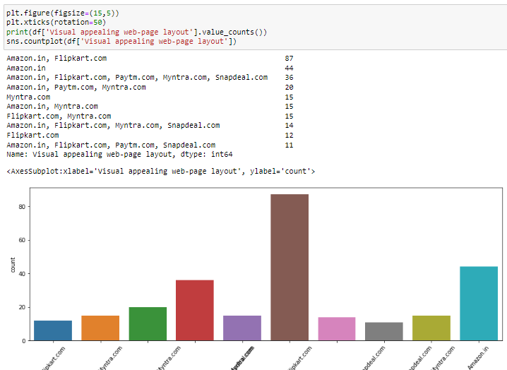
Majority Customers have strongly agreed that Amazon.in and Flipkart.com are the visual appealing web-page layout and rest following.

Slide 26
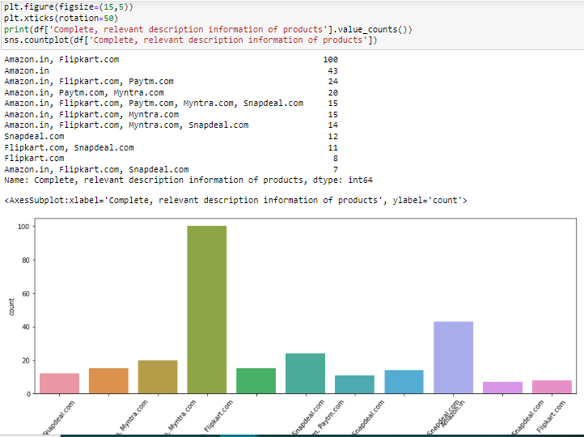
Majority Customers have strongly agreed that Amazon.in and Flipkart.com have the Complete, relevant description information of products and rest following.

Slide 27
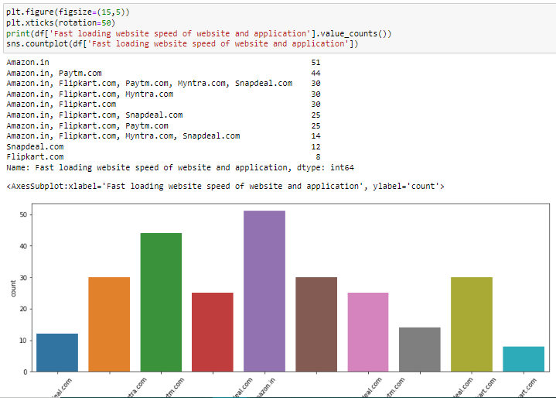
Majority Customers have strongly agreed that Amazon.in have the Fast loading website speed of website and application and rest following.

Slide 28
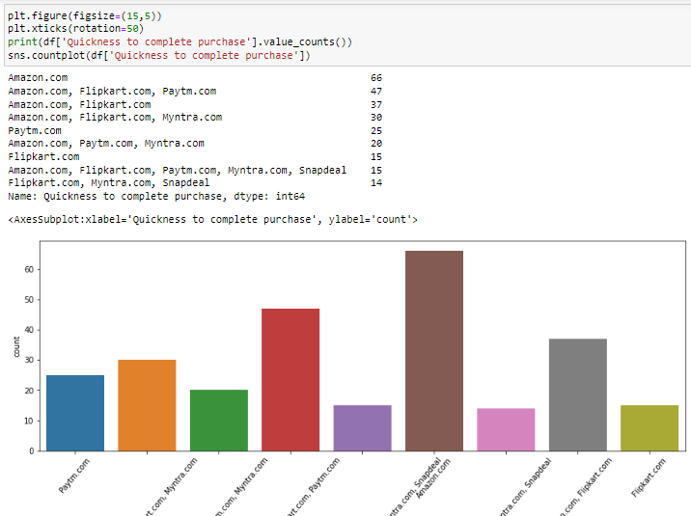
Majority Customers have strongly agreed that Amazon.in and Flipkart.com have the Quickness to complete purchase and rest following.

Slide 29

Majority Customers have strongly agreed that Amazon.in and Flipkart.com have the Availability of several payment options and rest following.

Slide 30

Majority Customers have strongly agreed that Amazon.in have the Speedy order delivery and rest following.

Slide 31

Majority Customers have strongly agreed that Amazon.in have Privacy of customers and rest following.

Slide 32

Majority Customers have strongly agreed that Amazon.in have the Perceived Trust worthiness and rest following.

Slide 33

Majority Customers have strongly agreed that Amazon.in and Flipkart.com have Presence of online assistance through multi-channel and rest following.

Slide 34

Customers have strongly agreed that Amazon.in have the longer time to get logged in and rest following.

Slide 35

Majority Customers have strongly agreed that Paytm.in and snapdeal.com have the Longer delivery period and rest following.

Slide 36

Majority Customers have strongly agreed that Amazon.in have the Change in website/application design and rest following.

Slide 37

Majority Customers have strongly agreed that Amazon.in is the Indian online retailer which they would recommend to their friends and rest following.

Slide 38

Majority Customers of 41-50 age group have strongly agreed that Amazon.in is the Indian online retailer which they would recommend to their friends and rest following.
Majority Customers of 31-40 age group have strongly agreed that Flipkart.com is the Indian online retailer which they would recommend to their friends and rest following.

Slide 39

Majority Female Customers have strongly agreed that Amazon.in is the Indian online retailer which they would recommend to their friends and rest following.

Slide 40

Majority Customers have strongly agreed that Amazon.in and flipkart.com have Wild variety of product on offer and rest following.

Slide 41
Outcomes from the data analysis:
In this project we have investigated ecommerce quality in online businesses and develop new knowledge to understand the most important dimensions of E-retail factor for customer activation and retention.
This project aimed to enhance prior understanding of how ecommerce websites affected customer satisfaction, customer trust, and customer behavior, i.e., repurchase intention, customer loyalty, and site revisit.
The dimensions like information about the products, convenient payment mode, Trust, Fulfilment, website design change, security/privacy and many others had a positive impact on the ecommerce websites for customers. Also, some of the dimensions like ease of navigation, loading and speed, late delivery etc did not have impact on the ecommerce websites.
Thus, a company needs to pay attention to these dimensions more specifically and seek breakthroughs that can improve its performance and e-service quality.
Customer satisfaction and customer trust appeared as the outcomes of overall e-retail factor. The results of the analysis showed that e-retail factor had a positive impact on customer satisfaction. The majority of research done about e-retail factor states that customer satisfaction is the main determinant impacting on e-retail factor. It supports the idea that there is a significant relationship between e-retail factor and customer satisfaction. E-retail factor also had a positive impact on customer trust. The better the e-retail factor of a company, the higher the customer trust. Providing good service quality enhances customer satisfaction and customer trust.

Slide 42
From the above analysis we found that the main reasons or factors which attract consumers to do shopping online and then main reasons or obstacles which discourage consumers from shopping online. Therefore, from the analysis, it is found that most of the respondents use internet daily but most of the respondents do not use internet daily to buy products. Nearly half of the total respondents' opinions were that they would only use the internet to buy products when the need arises to do so.
Transaction security and consumers data safety are principal concerns of online customers purchasing products or services online. Therefore online vendors can assure their consumers' by offering personal information privacy, protection policy and guarantee for transaction security by improving their technological systems.
Retailers should be careful about the annoying factors of online shopping such as being unable to access the website, long delays in completing online orders, inconsistencies in the items available online, mistakes in filling orders, and the hassle of returning goods.
Online sellers can be more concerned about delivery times, delivery charge and product return policies. They can make it easier, quicker and reliable, so that consumers can enjoy the online shopping experience.
Getting feedbacks from the customers is also on of the important thing to improve the sales of the company. The retailer wants to keep the customer happy in order to build the successful business, but they easily fall into a trap of assuming that the customers will give feedback without being prompted. If there is something wrong, most of the customers won’t complain, they will just go elsewhere. So it is important to ask customers how they really feel about their services.

Slide 43
Conclusions:
The endeavor of this study is to identify the motivating factors towards online shopping and in which we come to know the customers likely to shop more.
Visualized the data using count plot, factor plot, pie plot and distribution plot, also encoded the object data into numerical using label encoding method. Checked the statistical summary of the dataset.
From the analysis it was found that consumers purchasing decisions were dependent on various factors. All these motives motivate consumers to purchase products through online.
According to consumers' opinions, "time saving" is the most important motivating factor for online shopping.
Again "information availability", "open 24/7", "huge range of products/ brands", "reasonable prices", "various offers for online products", "easy ordering system", and "shopping fun" are other motivating factors for online shopping respectively. Also, "online payment system", "personal privacy or security issues", "delaying of delivery" and "lacks of personal customer service" are the main inhibitions of online shopping to the respondents.

Slide 44
After visualizing the data, I found Amazon is the best online store where the customers trust on buying products and it has positive impact on the customers. Also, amazon and flip kart have increased customers’ expectations. So, they are the best online retailer who makes the loyal customers and satisfies the customers.
It was also observed that online shopping is not trustworthy and reliable to some consumers due to only online payment system and personal privacy. In addition, online security is a major concern for the consumer particularly in terms of fraud, privacy and hacking. So, the organizers should make up their organization for better sales.
As in the final plot in which user were asked which online retailer they would recommend to a friend in this Amazon.in topped the list because it is providing all the features that users want. Website is efficient and it is fast loading, it gives complete, relevant description and information of products. It is reliable and quick to complete the purchase. Amazon give speedy delivery to its customers and there are several payment options available on the website. It provides online assistance through multi channels. Providing good deals on products. Its website have visual appealing webpage layout and they offer wide variety of products and its application is easy to use. Lastly the main thing why user recommend it is because of its Trustworthiness and its robust Security in protecting customer financial information and their Privacy information.
These all features make it top the list of recommended online retailer .Providing these features it is retaining its customers.

Slide 45
KEY FINDINGS AND CONCLUSIONS OF THE STUDY
Company with higher customer satisfaction and retention:
1. Amazon.com
2. Flipkart.com
Company with high risk of customer churn:
1. Snapdeal.com

